Slide 1
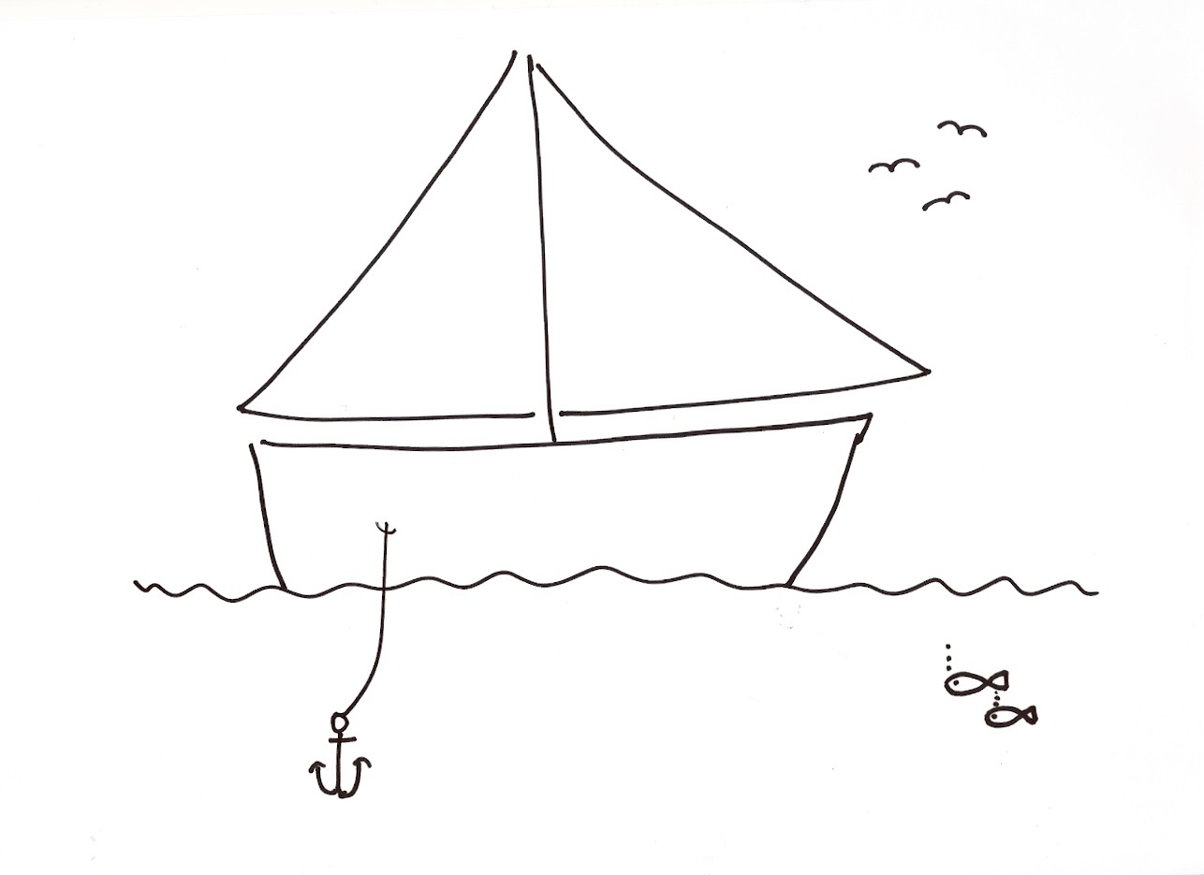
+1 improvement
Retrospective Sailing
Sail
+1 to +10
+8
NAME
Mission
-7
+1 improvement
Anchor
-1 to -10
@belindawaldock www.beingagile.co.uk belinda@beingagile.co.uk

